Slide 1
SD2231 : Lab 3 Group 19 Presentation
Akash Singh
Anirvan Dutta

Slide 2
Our unique feature
Combination of MATLAB and Simulink implementation
Intuitive grid search-based tuning of parameters for PD, PID, Skyhook controller for 1 DOF system.
Analysis of MIMO system for vehicle model for bounce and pitch for better design of controllers.

Slide 3

Our most difficult part
Derivation of model for 2 DOF and vehicle model.
Understanding of MIMO system and $H_{∞}$ controller.
Creating Simulink simulation for feedback-based Skyhook controller and $H_{∞}$ controller.

Slide 4


Task 1: 1 DOF passive system
Derivation of 1 DOF passive system
Natural Frequency Damping Coefficient
If excited at natural frequency, the system will enter into unstable oscillations
Damping Coefficient gives an idea about the oscillations in the system output to any change in the system input.
*impulse responses of different system shown along with results of Task 1.4
$$ω_{n}= \sqrt{\frac{k_{p}}{m_{p}}}$$
$$ζ= \frac{c_{p}}{2\sqrt{k_{p}m_{p}}}$$
Notes:
If ζ=0, the system is undamped and the step input will simply send the system into undamped free oscillation. If 0<ζ<1 we call the system underdamped and we observe prolonged oscillatory motion as the system returns to the value of the step input. If ζ=1 the system is critically damped, and there are no observed oscillations from a step input.

Slide 5
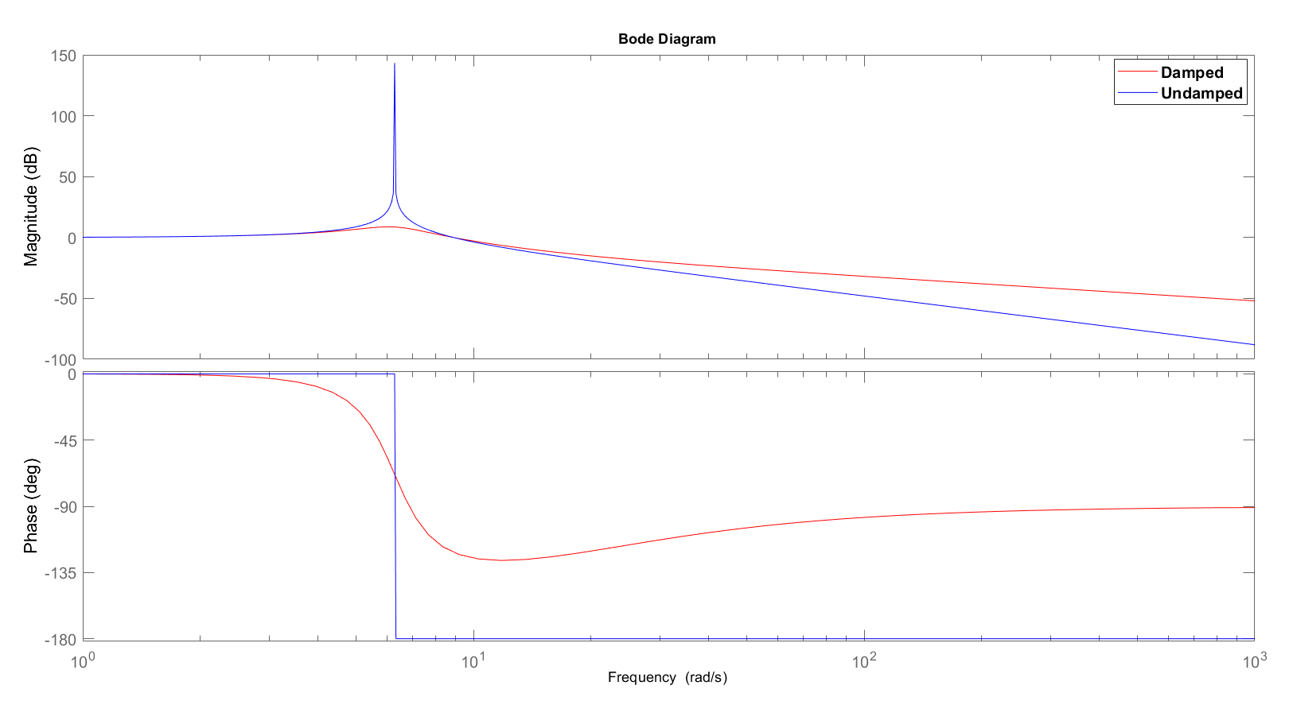
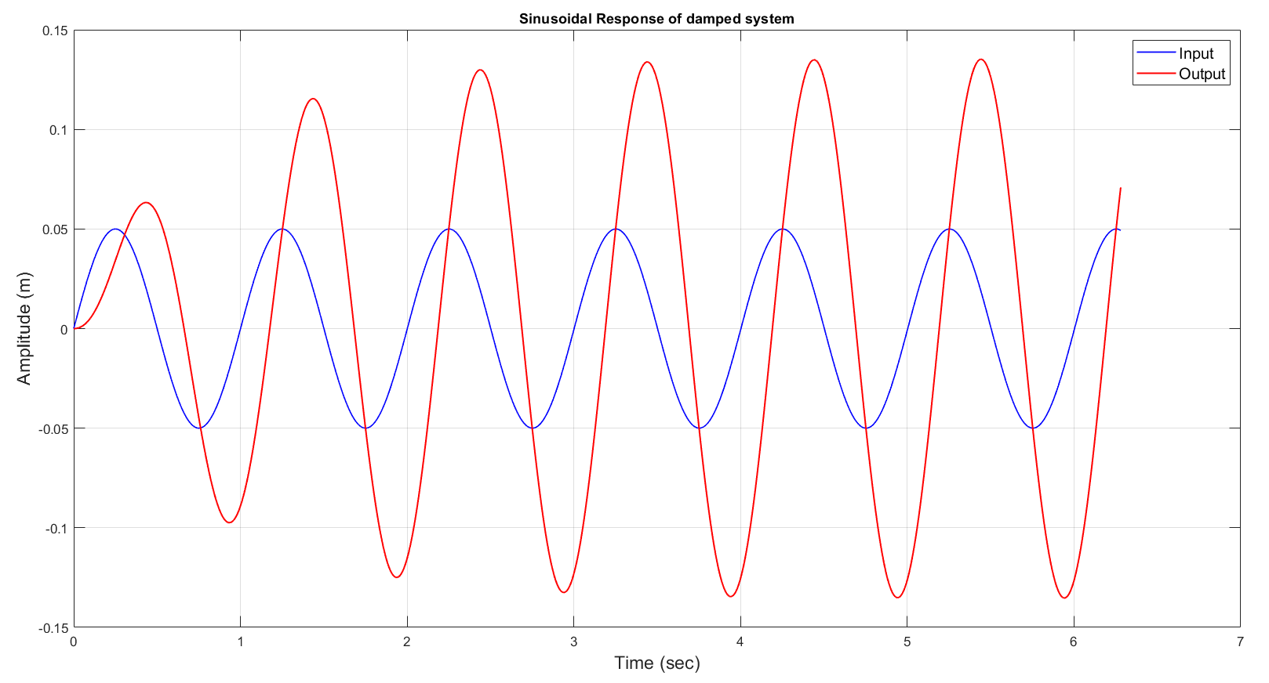
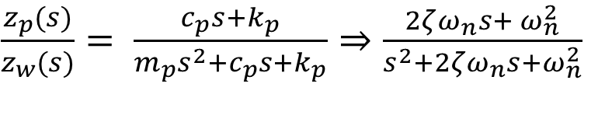
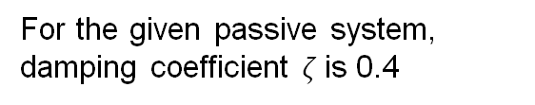
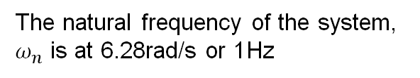
Task 1: 1 DOF passive system
Implementation of 1 DOF passive system
$\frac{z_{p}(s)}{z_{w}(s)}= \frac{c_{p}s+k_{p}}{m_{p}s^{2}+c_{p}s+k_{p}}$ $⇒\frac{2ζω_{n}s+ ω_{n}^{2}}{s^{2}+2ζω_{n}s+ω_{n}^{2}}$
The natural frequency of the system, $ω_{n}$ is at 6.28rad/s or 1Hz
For the given passive system, damping coefficient $ζ$is 0.4
Notes:
Comparison of bode for cp = 0 and cp = given.
Calculation of $ω_{n}$ matches with the one obtained from bode plot as well
Since nat freq is 1 Hz, system response towards input Sine wave of 1Hz would be interesting to see

Slide 6
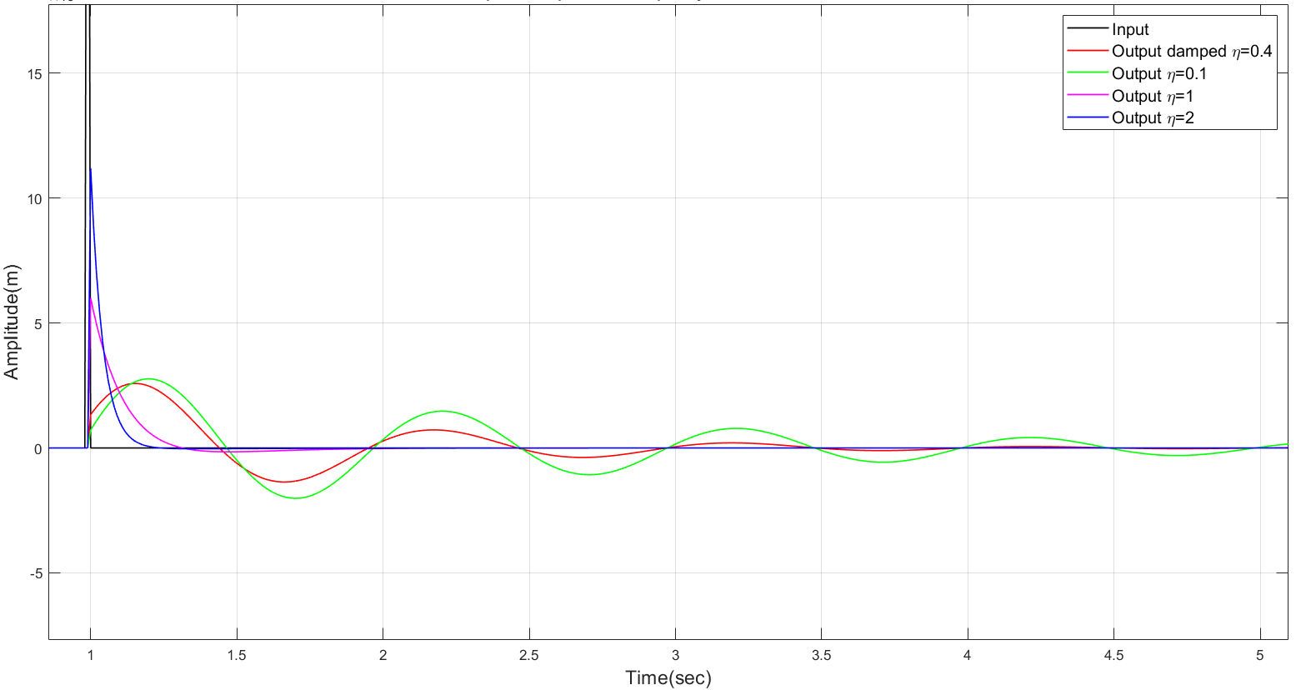
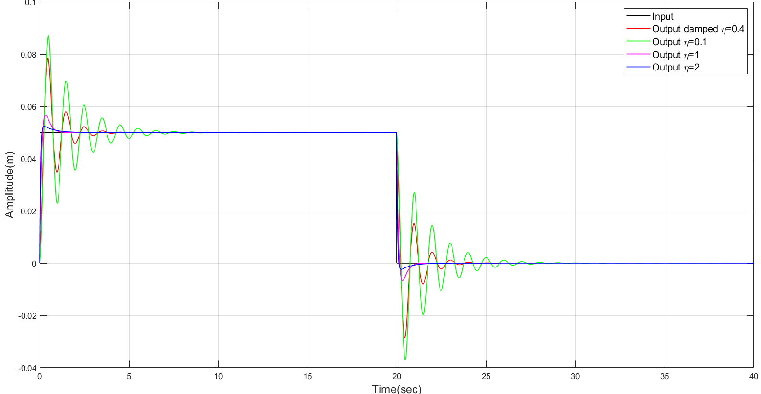

Task 1: 1 DOF Passive Damped system
Implementation of 1 DOF passive system: lsim
Effect of Damping
Coefficient, $ζ$
$ζ=0.1$ – under damped
$ζ=1$ – critically damped
$ζ=2$ – over damped

Slide 7



Task 2: 1 DOF active system
Derivation of 1 DOF active system:
PD control
So, $d_{d} ≈ c_{p},$and
$d_{p} ≈0$, for initial estimates.
$$\frac{z_{p}(s)}{z_{w}(s)}= \frac{k_{p}}{m_{p}s^{2}+d_{d}s+(k_{p}+d_{p})}$$
$$m_{p}s^{2}+c_{p}s+k_{p}$$
Notes:
Transfer function for closed loop system using a PD controller.
Comparing the denominator with that of the original TF, we can get approximately similar output response.

Slide 8
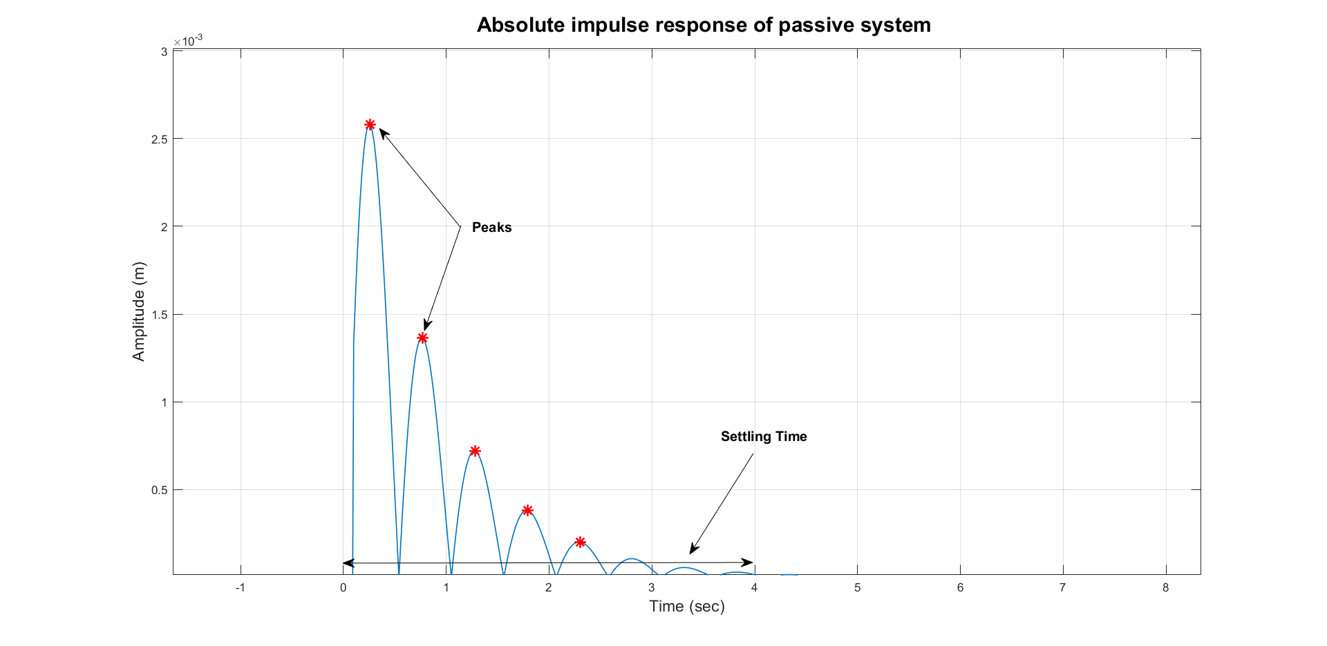
Task 2: 1 DOF active system
Implementation of 1 DOF active system:
Tuning the PD controller using grid search
Overshoot reduction : Comparing of the magnitude of sinusoidal and impulse response magnitude
Ensuring oscillation : Determining the peaks of impulse response and ensuring is under critically damped response.
Ensuring faster damping : Comparing the steady state time of impulse response
Notes:
Ran a 2-D grid search on the dd and dp values, with the give performance requirements as the constraints.
i.e, The output should always have peaks(at most 3) to ensure an under critically damped response while the settling time and overshoot should be smaller than the untuned case.
Since the natural frequency should not be changed, we kept the value of kp close to zero.

Slide 9
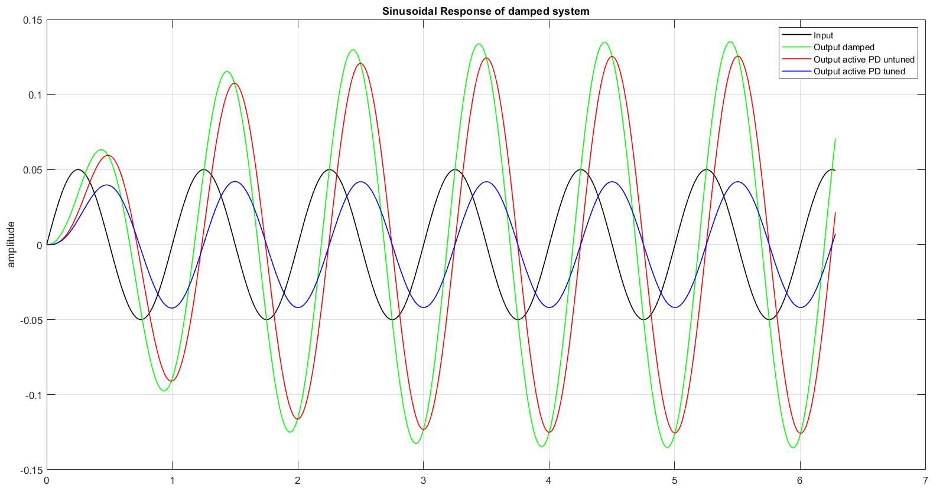
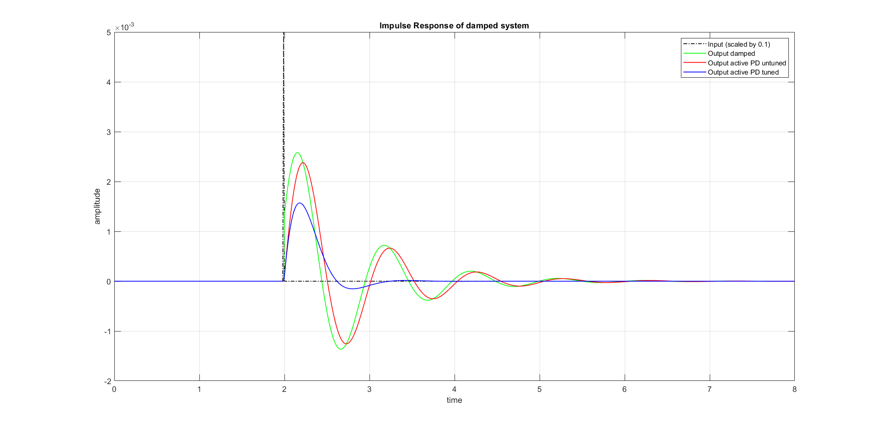
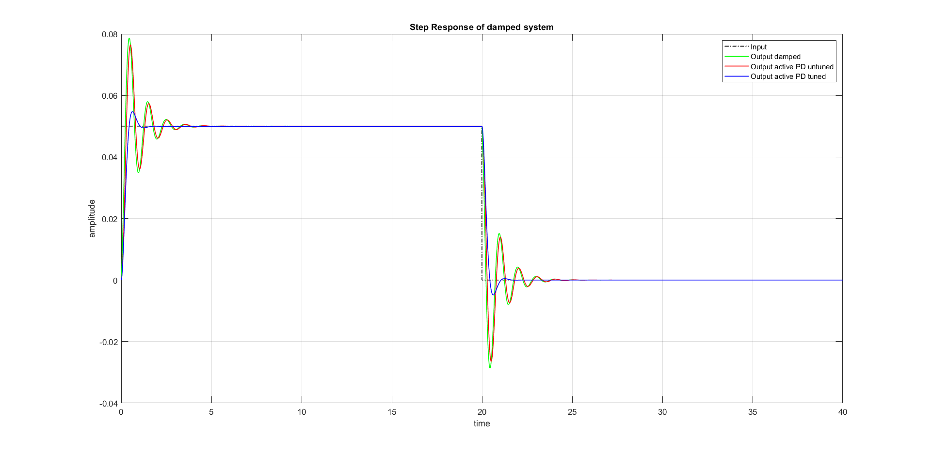
Task 2: 1 DOF active system
Results of PD Control to different excitation:
Notes:
The output response to different input significantly improves upon tuning. Much lower oscillations in all cases and faster settling time in case of impulse and/or step input.

Slide 10
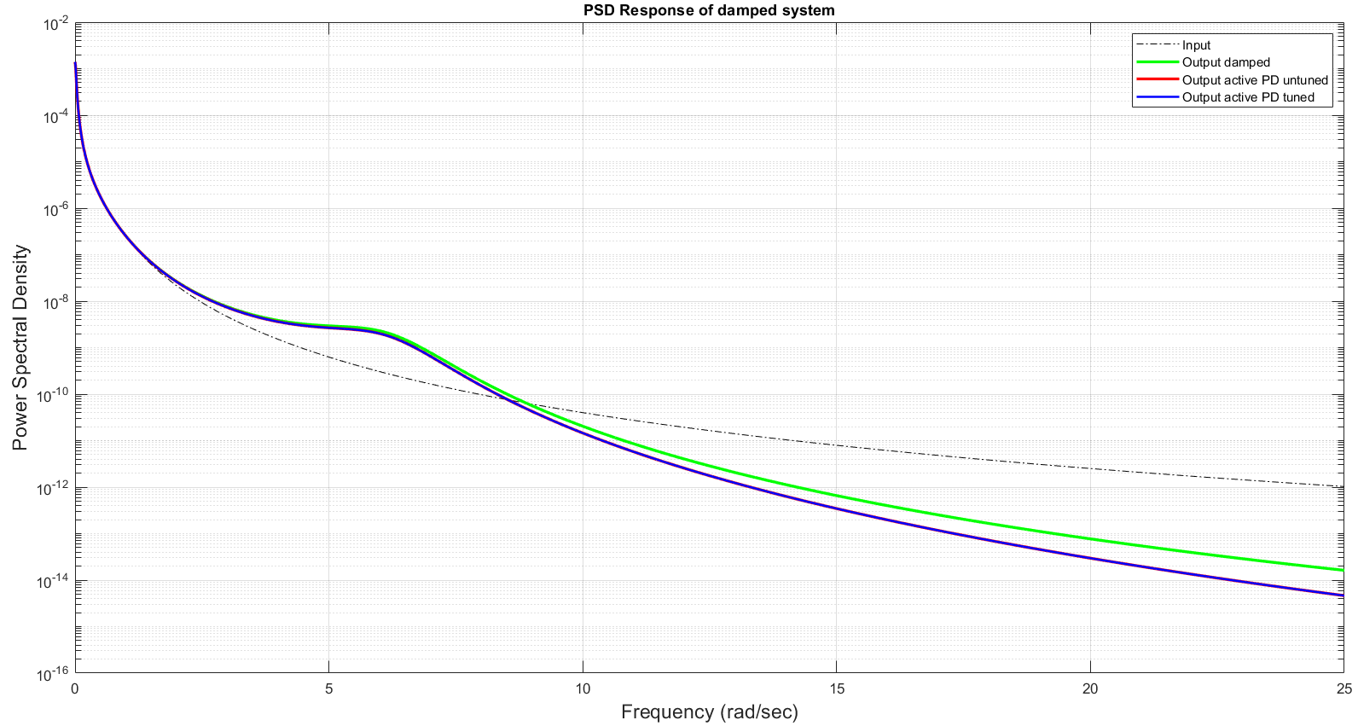
Task 2: 1 DOF active system
Results of PD Control
Notes:
The response of the tuned and the untuned controller does not differ much but wrt passive system the noise amplification has been reduced, since we have got rid of the system zero.

Slide 11
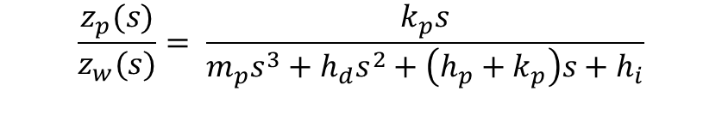

Task 3 & 4: 1 DOF active system
Derivation of controllers:
PID
Skyhook
$$\frac{z_{p}(s)}{z_{w}(s)}= \frac{k_{p}s}{m_{p}s^{3}+h_{d}s^{2}+\left(h_{p}+k_{p}\right)s+h_{i}}$$
$$\frac{z_{p}(s)}{z_{w}(s)}= \frac{k_{p}}{m_{p}s^{2}+Ts+k_{p}}$$
Notes:
The transfer functions are found to be as depicted. Similar tuning technique as previously used has been used in both of these cases as well but combining the results and implementation here as a respect towards space and time.

Slide 12
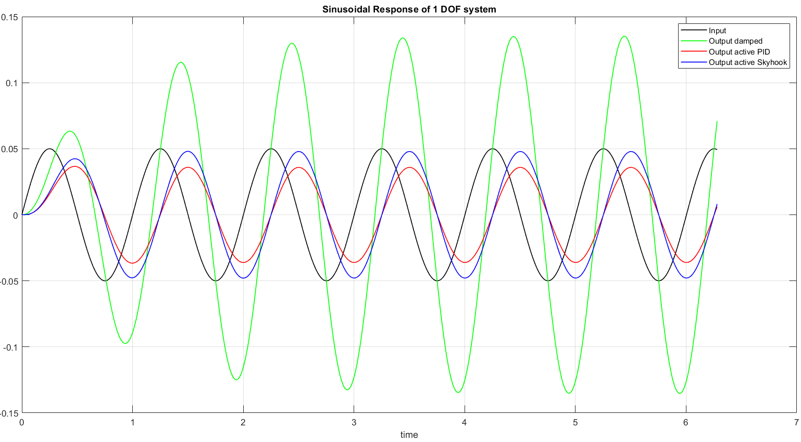
Task 3 & 4: 1 DOF active system
Results of PID & Skyhook Control to different excitation:
Notes:
Comparing the sinusoidal and impulse inputs, the PID(in red) appears to be working better than skyhook controller(in blue).

Slide 13
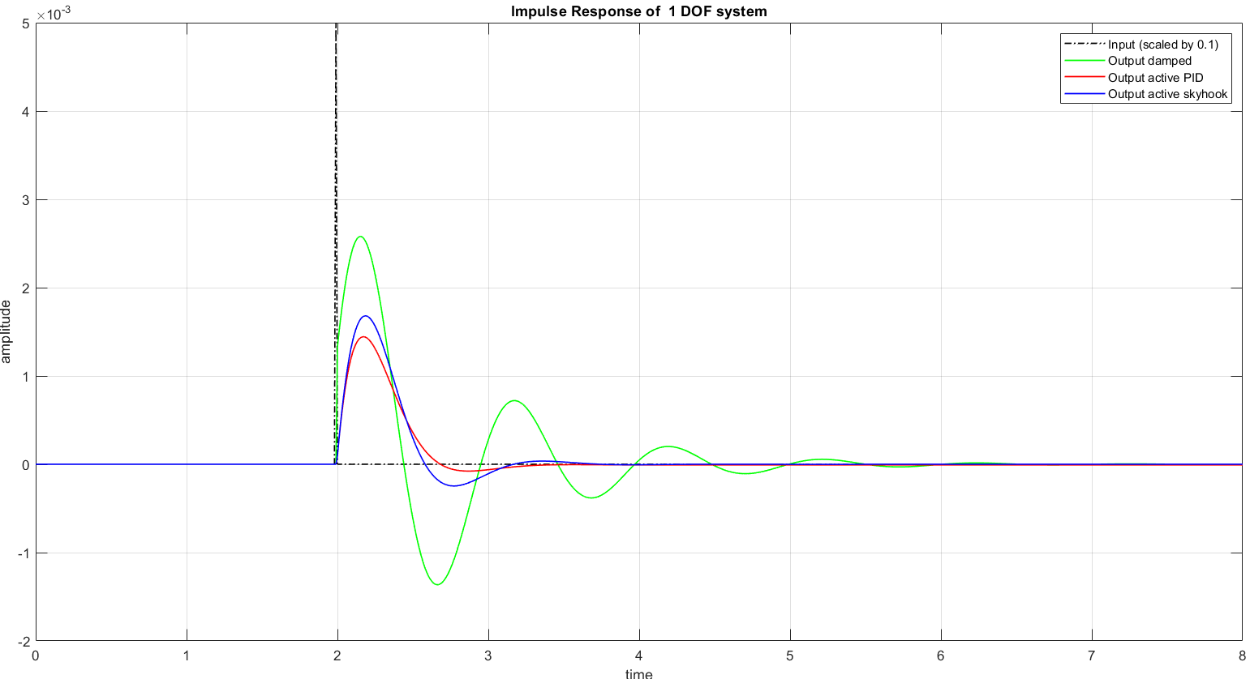
Task 3 & 4: 1 DOF active system
Results of PID & Skyhook Control to different excitation:
Notes:
Comparing the sinusoidal and impulse inputs, the PID(in red) appears to be working better than skyhook controller(in blue).

Slide 14
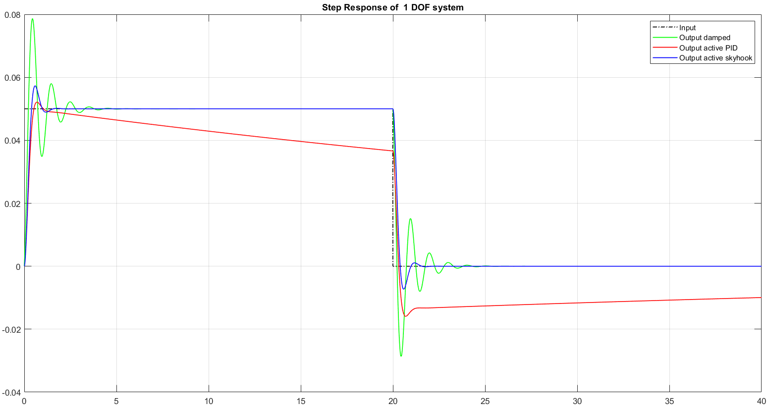
Task 3 & 4: 1 DOF active system
Results of PID & Skyhook Control to different excitation:
Notes:
But when we look at the step response, we can see the problem with PID controller. As the integral controller always tries to drive the output towards zero, and does not reach the intended steady state.
Physically it would mean, if the elevation of the road increases, the suspension system would slowly go back to its initial state. As a result, the ground clearance of the vehicle would decrease.
The skyhook controller scores over PID in this case.

Slide 15
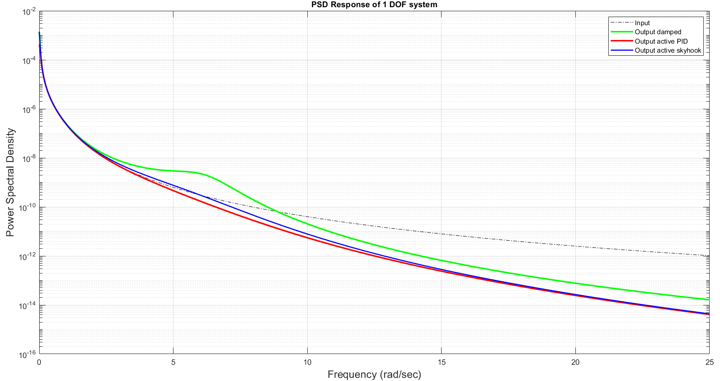
Task 3 & 4: 1 DOF active system
Results of PID & Skyhook Control to different excitation:

Slide 16
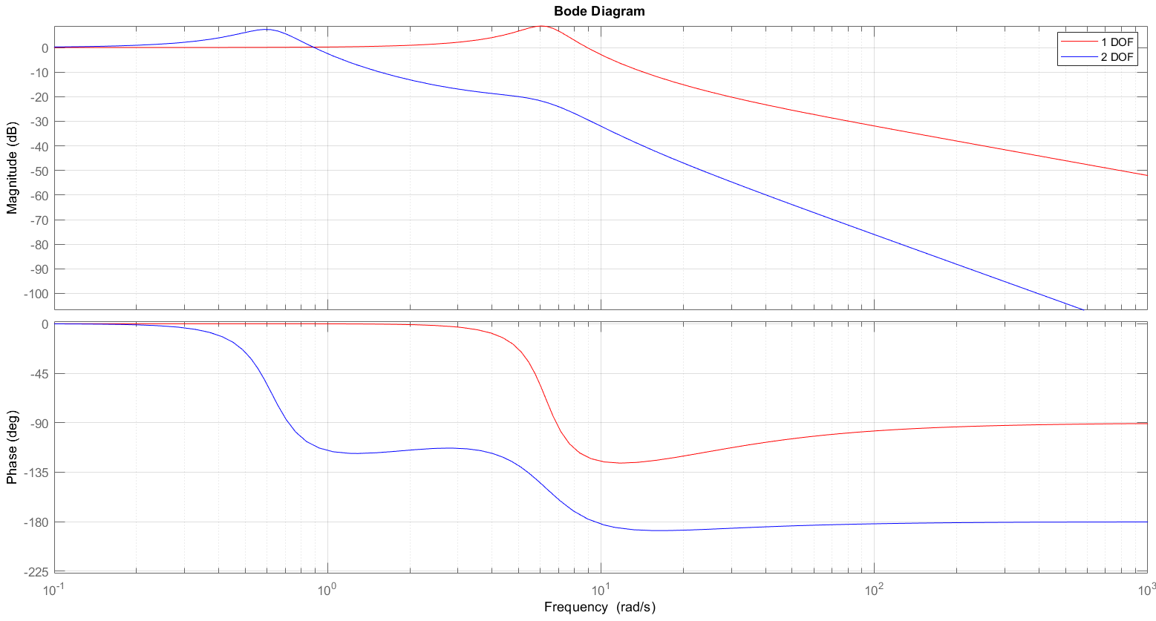
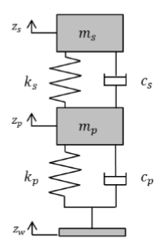
Task 5: 2 DOF passive system
Derivation and analysis of 2 DOF passive system:
$$\frac{z_{s}(s)}{z_{w}(s)}= \frac{c_{p}c_{s}s^{2} + \left(c_{p}k_{s}+c_{s}k_{p}\right)s +k_{p}k_{s}}{m_{p}m_{s}s^{4}+\left(m_{s}c_{p}+m_{s}c_{s}+m_{p}c_{s}\right)s^{3}+\left(m_{s}k_{p}+m_{s}k_{s}+m_{p}k_{s}+c_{p}c_{s}\right)s^{2}+\left(c_{s}k_{p}+c_{p}k_{s}\right)s+k_{p}k_{s}}$$
Reduced Bandwidth
Notes:
For the 2-Dof system, This is coupled mass system, where the input is not applied at the mass whose motion is being observed. Transfer function between the second mass and the platform/wheel/road has a 4th order characteristic equation. While it is much more resilient to noise in the input, the bandwidth of the system(according to crossover frequency definition) has decreased, which means the system is much more difficult to control than in 1-DOF case.

Slide 17
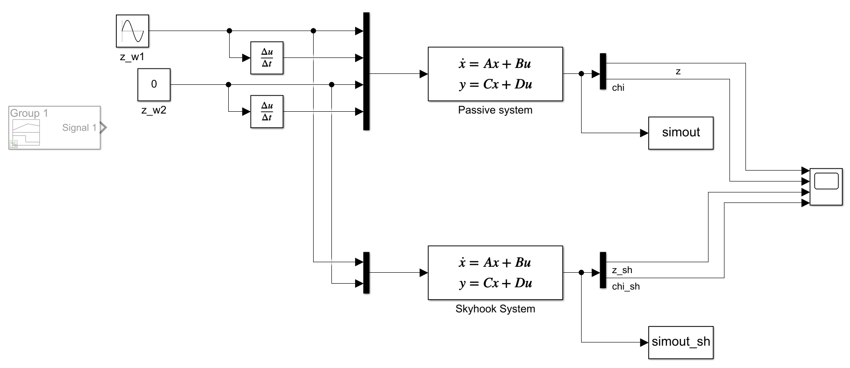

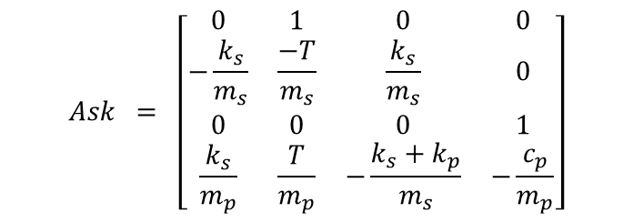


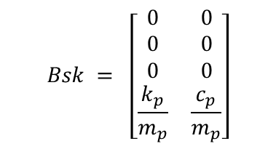

Task 5: 2 DOF Skyhook control system
Implementation of Skyhook control:
State space representation and simulation using Simulink
$$x = {\left[\begin{matrix}z_{s} & {\dot{z}}_{s} z_{p}{ \dot{z}}_{p}\end{matrix}\right]}^{T}$$
$$u = {\left[\begin{matrix}z_{w} & {\dot{z}}_{w} \end{matrix}\right]}^{T}$$
$$Ask = \left[\begin{matrix}\begin{matrix}0 & 1 & 0 & 0 \\ −\frac{k_{s}}{m_{s}} & \frac{−T}{m_{s}} & \frac{k_{s}}{m_{s}} & 0 \\ 0 & 0 & 0 & 1 \\ \frac{k_{s}}{m_{p}} & \frac{T}{m_{p}} & −\frac{k_{s}+k_{p}}{m_{s}} & −\frac{c_{p}}{m_{p}}\end{matrix}\end{matrix}\right]$$
$$Bsk = \left[\begin{matrix}\begin{matrix}0 & 0 \\ 0 & 0 \\ 0 & 0 \\ \frac{k_{p}}{m_{p}} & \frac{c_{p}}{m_{p}}\end{matrix}\end{matrix}\right]$$
$$Csk = \left[\begin{matrix}1 & 0 & 0 & 0\end{matrix}\right]$$
$$Dsk = \left[\begin{matrix}0 & 0\end{matrix}\right]$$
Fig: Simulink implementation of 2 DOF system
Notes:
The state space model for Skyhook controlled closed loop system was derived and implemented in Simulink.

Slide 18
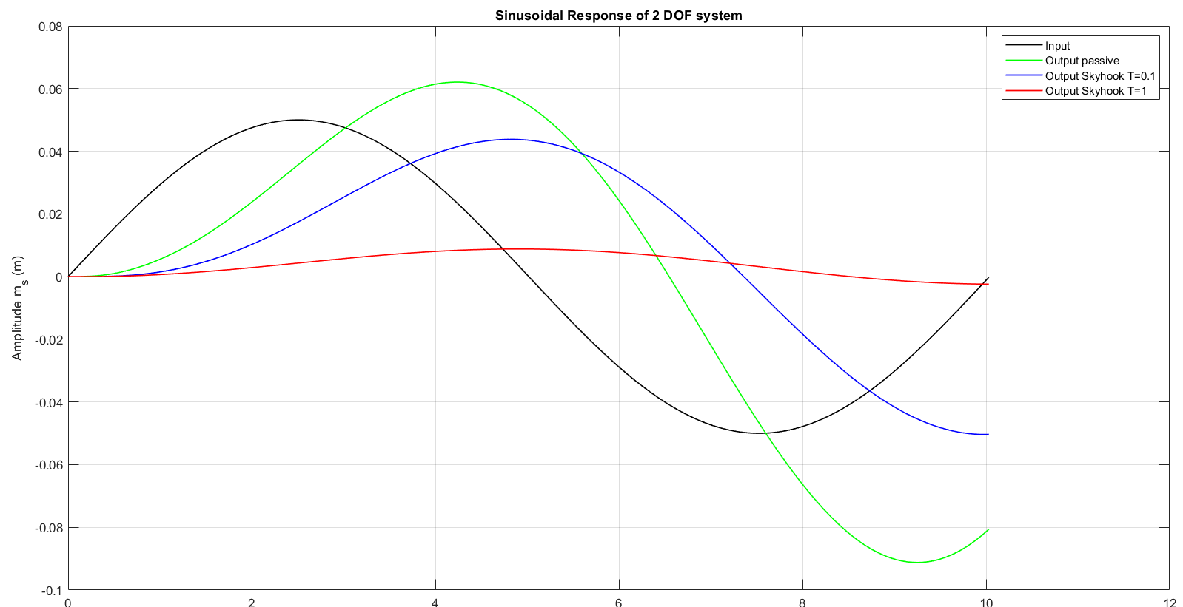
Task 5: 2 DOF Skyhook control system
Results of Skyhook Control to different excitation:
Notes:
The results of 3 excitations when using a skyhook controller vs a passive damped system

Slide 19
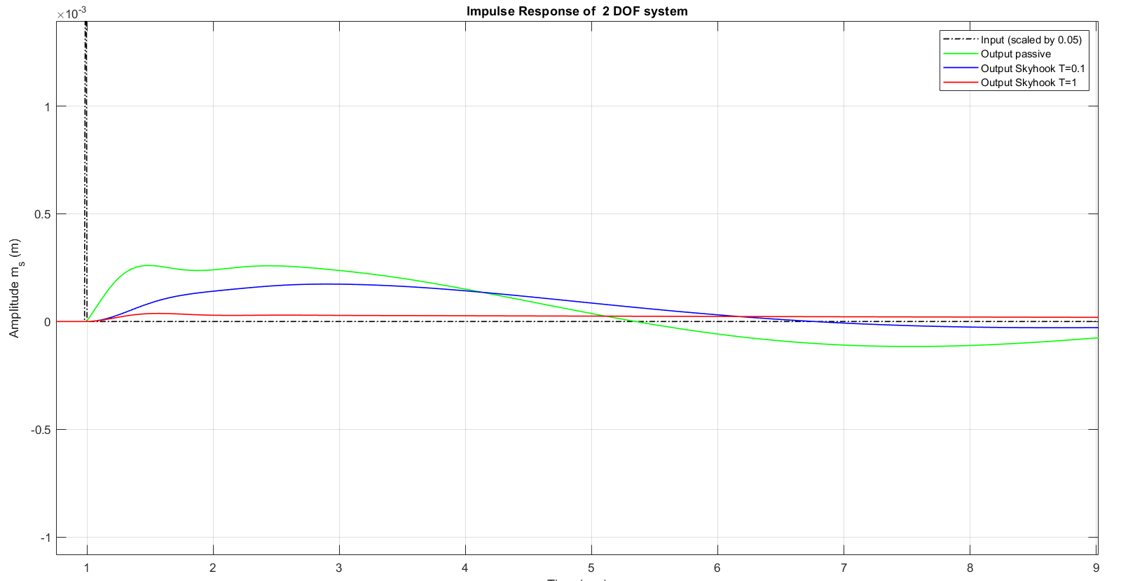
Task 5: 2 DOF Skyhook control system
Results of Skyhook Control to different excitation:

Slide 20
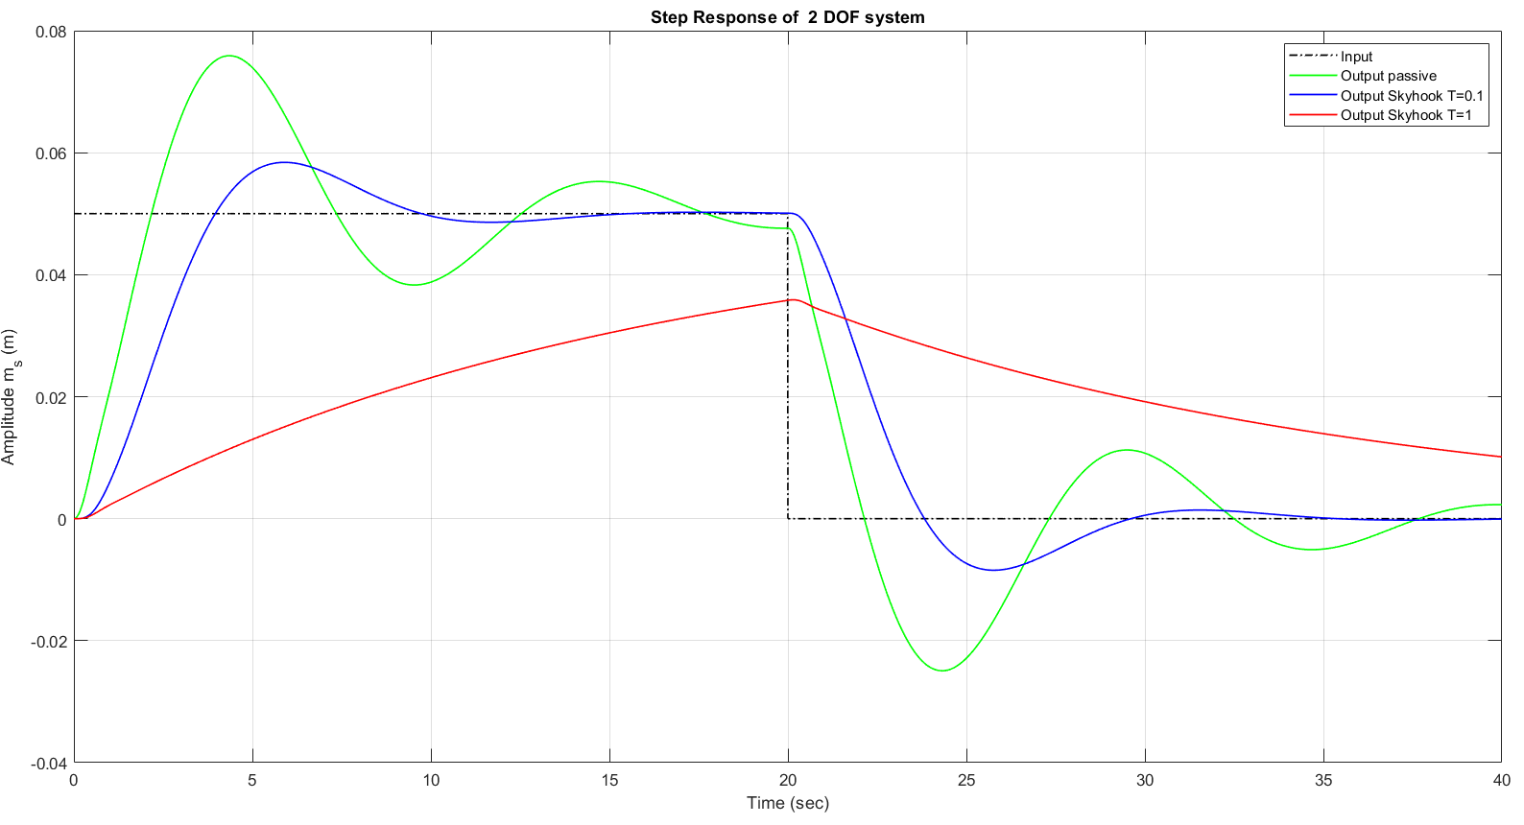
Task 5: 2 DOF Skyhook control system
Results of Skyhook Control to different excitation:
Notes:
The results of 3 excitations when using a skyhook controller vs a passive damped system.

Slide 21
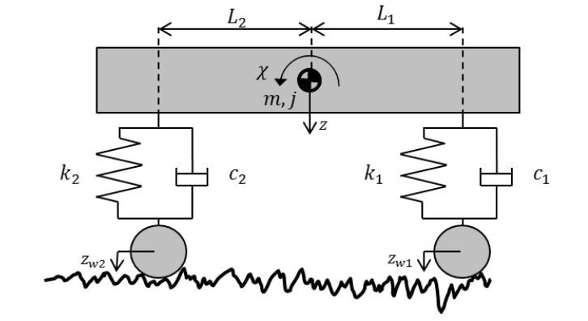
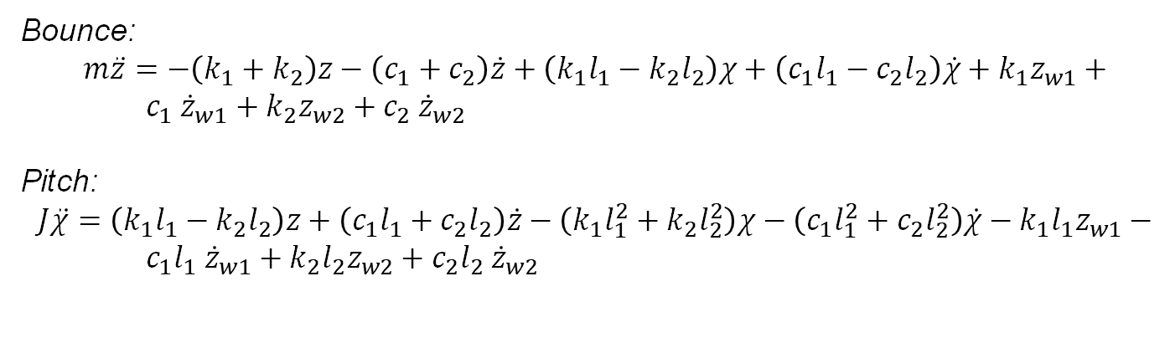
Task 6: Control of bounce and pitch for vehicle model
Derivation of passive model
Passive System
Fig: Passive vehicle model
Bounce:
$$m\ddot{z}=−\left(k_{1}+k_{2}\right)z−\left(c_{1}+c_{2}\right)\dot{z}+\left(k_{1}l_{1}−k_{2}l_{2}\right)χ+\left(c_{1}l_{1}−c_{2}l_{2}\right)\dot{χ}+k_{1}z_{w1}+$$
$c_{1} {\dot{z}}_{w1}+k_{2}z_{w2}+c_{2} {\dot{z}}_{w2}$
Pitch:
$$J\ddot{χ}=\left(k_{1}l_{1}−k_{2}l_{2}\right)z+\left(c_{1}l_{1}+c_{2}l_{2}\right)\dot{z}−\left(k_{1}l_{1}^{2}+k_{2}l_{2}^{2}\right)χ−\left(c_{1}l_{1}^{2}+c_{2}l_{2}^{2}\right)\dot{χ}−k_{1}l_{1}z_{w1}−$$
$c_{1}l_{1} {\dot{z}}_{w1}+k_{2}l_{2}z_{w2}+c_{2}l_{2} {\dot{z}}_{w2}$

Slide 22
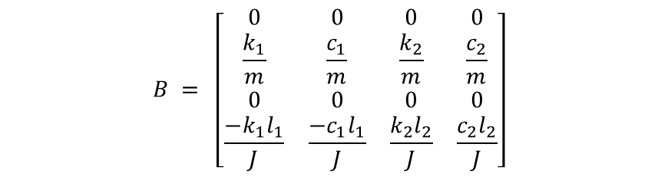

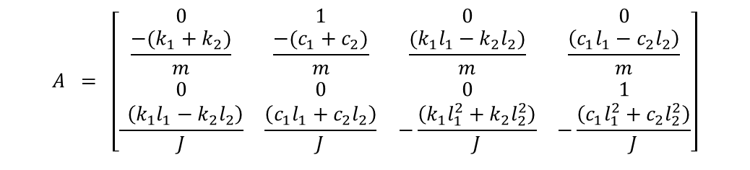



Task 6: Control of bounce and pitch for vehicle model
Implementation
Derived state space representation of passive model
$$x = {\left[\begin{matrix}z & \dot{z} χ \dot{χ}\end{matrix}\right]}^{T}$$
$$u = {\left[\begin{matrix}z_{w1} & {\dot{z}}_{w1} z_{w2} {\dot{z}}_{w2}\end{matrix}\right]}^{T}$$
$$A = \left[\begin{matrix}\begin{matrix}0 & 1 & 0 & 0 \\ \frac{−(k_{1}+k_{2})}{m} & \frac{−(c_{1}+c_{2})}{m} & \frac{{(k}_{1}l_{1}−k_{2}l_{2})}{m} & \frac{\left(c_{1}l_{1}−c_{2}l_{2}\right)}{m} \\ 0 & 0 & 0 & 1 \\ \frac{ \left(k_{1}l_{1}−k_{2}l_{2}\right)}{J} & \frac{\left(c_{1}l_{1}+c_{2}l_{2}\right)}{J} & −\frac{\left(k_{1}l_{1}^{2}+k_{2}l_{2}^{2}\right)}{J} & −\frac{\left(c_{1}l_{1}^{2}+c_{2}l_{2}^{2}\right)}{J}\end{matrix}\end{matrix}\right]$$
$$B = \left[\begin{matrix}\begin{matrix}0 & 0 & 0 & 0 \\ \frac{k_{1}}{m} & \frac{c_{1}}{m} & \frac{k_{2}}{m} & \frac{c_{2}}{m} \\ 0 & 0 & 0 & 0 \\ \frac{{−k}_{1}l_{1}}{J} & \frac{{−c}_{1}l_{1}}{J} & \frac{k_{2}l_{2}}{J} & \frac{c_{2}l_{2}}{J}\end{matrix}\end{matrix}\right]$$
$$C = \left[\begin{matrix}0 & 1 & 0 & 0 \\ 0 & 0 & 0 & 1\end{matrix}\right]$$
$$D = zeros(2, 4)$$

Slide 23
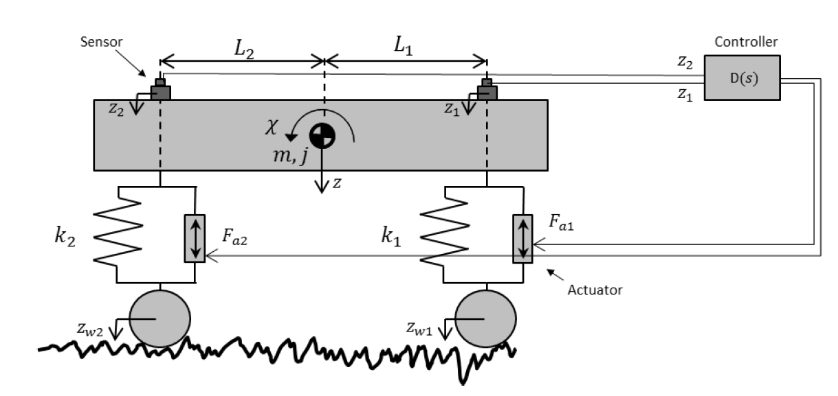
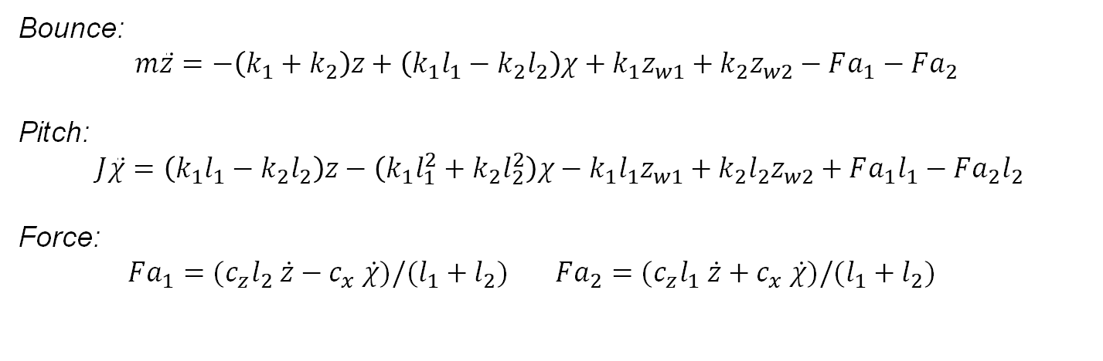
Task 6: Control of bounce and pitch for vehicle model
Derivation of Skyhook model
Active System
Fig: Active control vehicle model
Bounce:
$m\ddot{z}=−\left(k_{1}+k_{2}\right)z+\left(k_{1}l_{1}−k_{2}l_{2}\right)χ+k_{1}z_{w1}+k_{2}z_{w2}−Fa_{1}−Fa_{2}$
Pitch:
$$J\ddot{χ}=\left(k_{1}l_{1}−k_{2}l_{2}\right)z−\left(k_{1}l_{1}^{2}+k_{2}l_{2}^{2}\right)χ−k_{1}l_{1}z_{w1}+k_{2}l_{2}z_{w2}+Fa_{1}l_{1}−Fa_{2}l_{2}$$
Force:
$Fa_{1}=(c_{z}l_{2} \dot{z}−c_{x} \dot{χ})/(l_{1}+l_{2})$ $Fa_{2}=(c_{z}l_{1} \dot{z}+c_{x} \dot{χ})/(l_{1}+l_{2})$
Notes:
The force eqns were derived by balancing the net force and torque provided by the controller

Slide 24
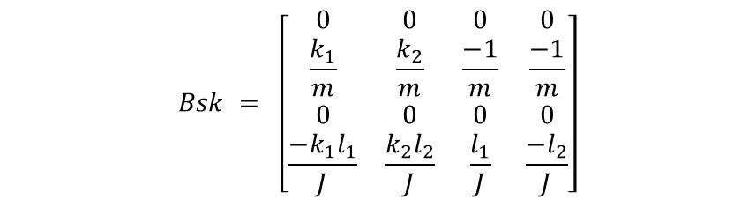

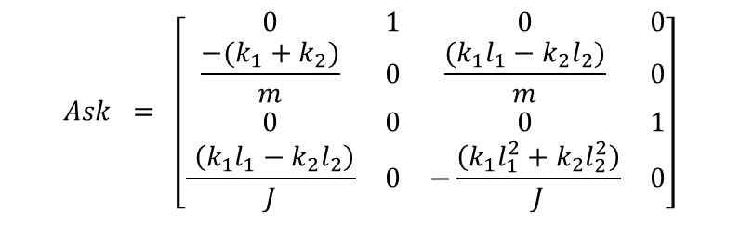


Task 6: Control of bounce and pitch for vehicle model
Implementation
Derived state space representation of skyhook model
$$x = {\left[\begin{matrix}z & \dot{z} χ \dot{χ}\end{matrix}\right]}^{T}$$
$$u = {\left[\begin{matrix}z_{w1} & z_{w2} Fa_{1} Fa_{2}\end{matrix}\right]}^{T}$$
$$Ask = \left[\begin{matrix}\begin{matrix}0 & 1 & 0 & 0 \\ \frac{−(k_{1}+k_{2})}{m} & 0 & \frac{{(k}_{1}l_{1}−k_{2}l_{2})}{m} & 0 \\ 0 & 0 & 0 & 1 \\ \frac{ \left(k_{1}l_{1}−k_{2}l_{2}\right)}{J} & 0 & −\frac{\left(k_{1}l_{1}^{2}+k_{2}l_{2}^{2}\right)}{J} & 0\end{matrix}\end{matrix}\right]$$
$$Bsk = \left[\begin{matrix}\begin{matrix}0 & 0 & 0 & 0 \\ \frac{k_{1}}{m} & \frac{k_{2}}{m} & \frac{−1}{m} & \frac{−1}{m} \\ 0 & 0 & 0 & 0 \\ \frac{{−k}_{1}l_{1}}{J} & \frac{k_{2}l_{2}}{J} & \frac{l_{1}}{J} & \frac{−l_{2}}{J}\end{matrix}\end{matrix}\right]$$
$$Csk = \left[\begin{matrix}0 & 1 & 0 & 0 \\ 0 & 0 & 0 & 1\end{matrix}\right]$$
$$Dsk = zeros(2, 4)$$

Slide 25
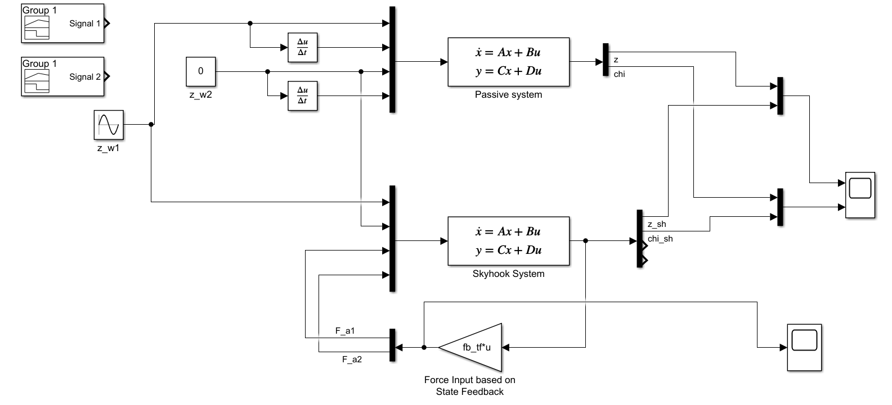

Task 6: Control of bounce and pitch for vehicle model
Implementation
Utilized signal generation feature to provide different excitation.
Iterative tuning of parameters of the controller - ${c_{z}={10}^{5} ; c}_{χ}=3×{10}^{6}$
Fig: Simulink implementation Skyhook controller

Slide 26
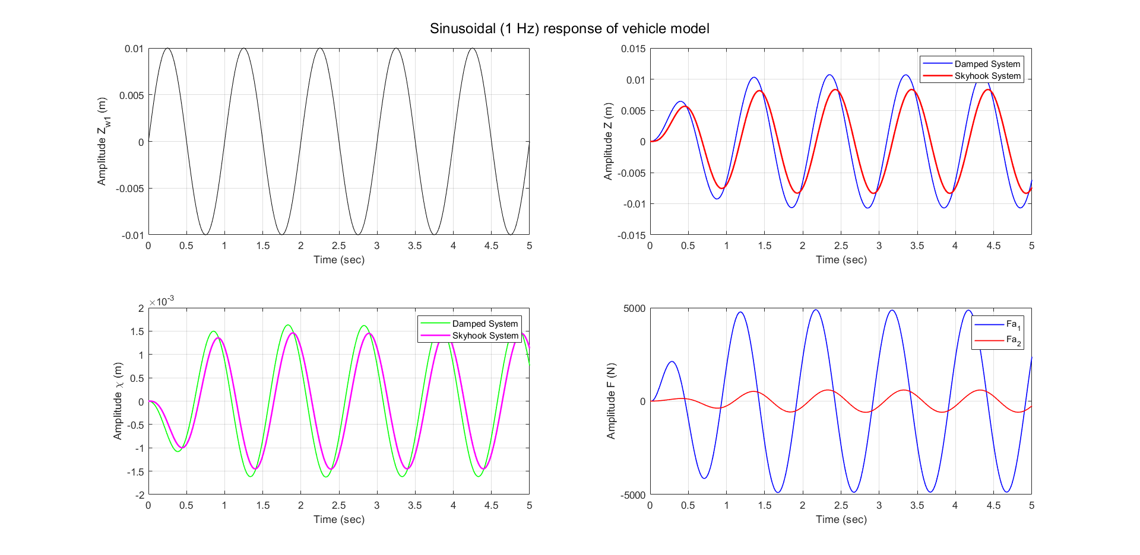
Task 6: Control of bounce and pitch for vehicle model
Results – Base excitation 1

Slide 27
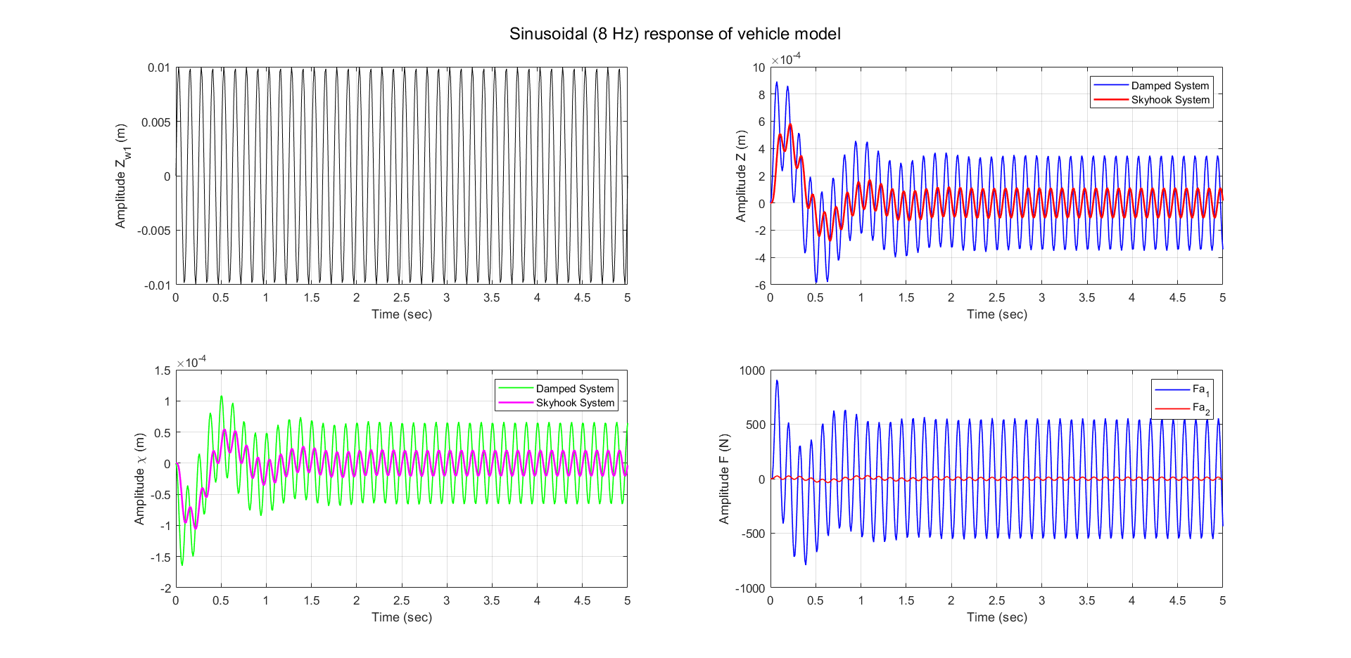
Task 6: Control of bounce and pitch for vehicle model
Results – Base excitation 2

Slide 28
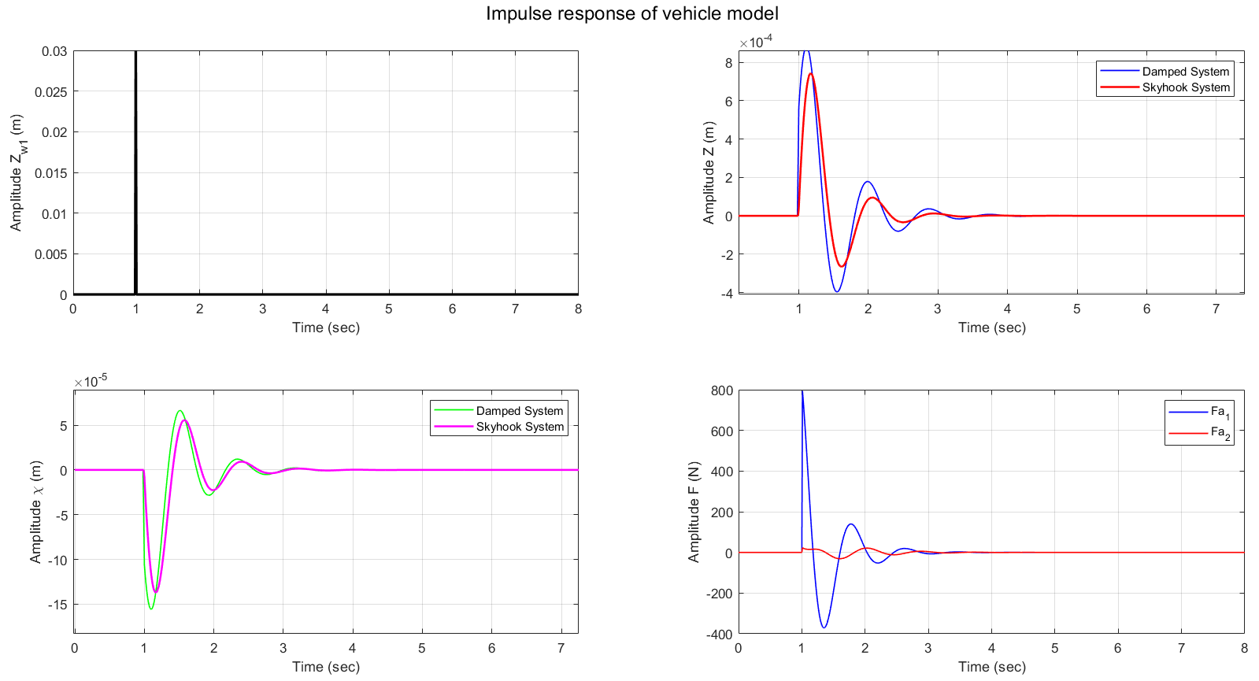
Task 6: Control of bounce and pitch for vehicle model
Results – Base excitation 3

Slide 29
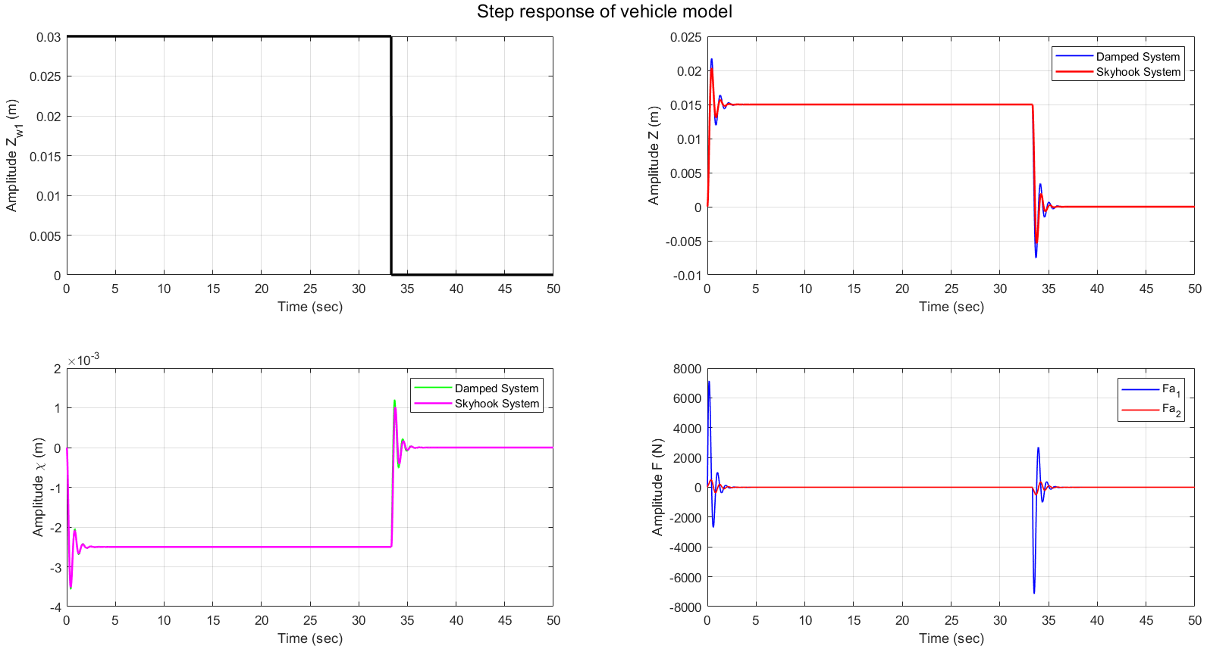
Task 6: Control of bounce and pitch for vehicle model
Results – Base excitation 4

Slide 30
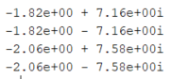

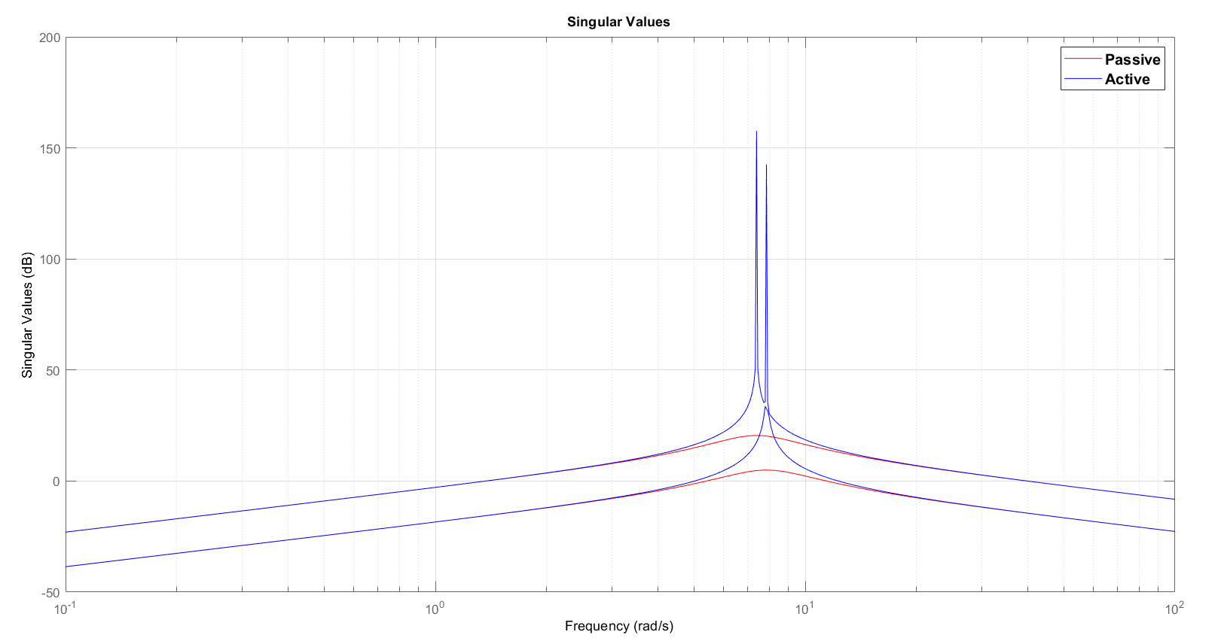

Task 6: Control of bounce and pitch for vehicle model
Design of $H_{∞}$ controller
Poles of the A and $Ask$ matrix was calculated:
Individual transfer function of the skyhook model was obtained
Poles of passive
Poles of active

Slide 31
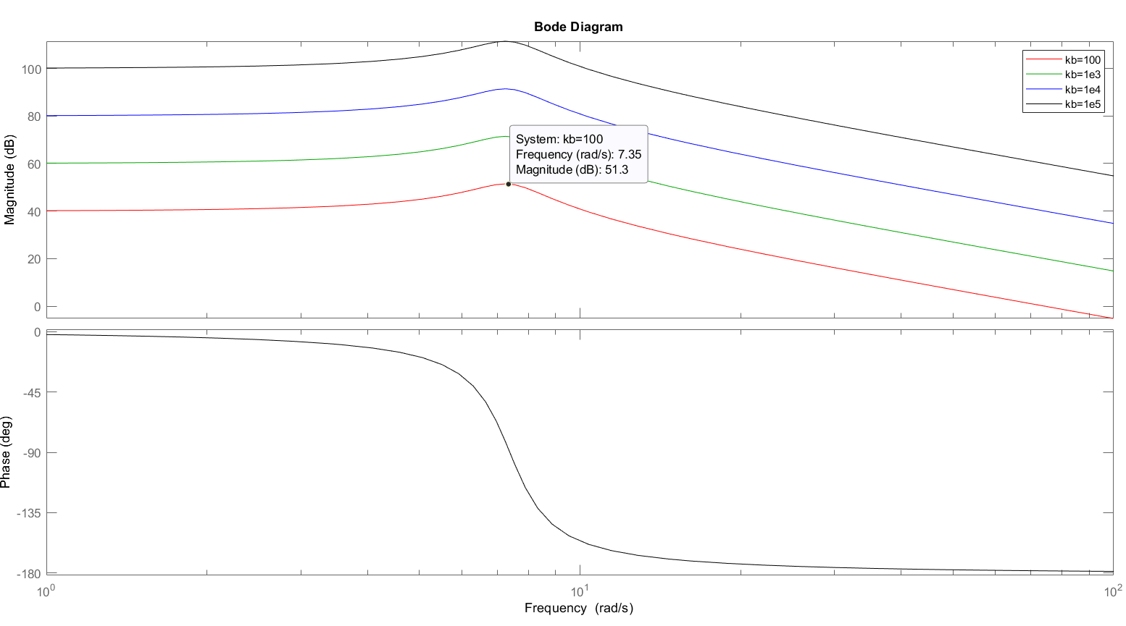
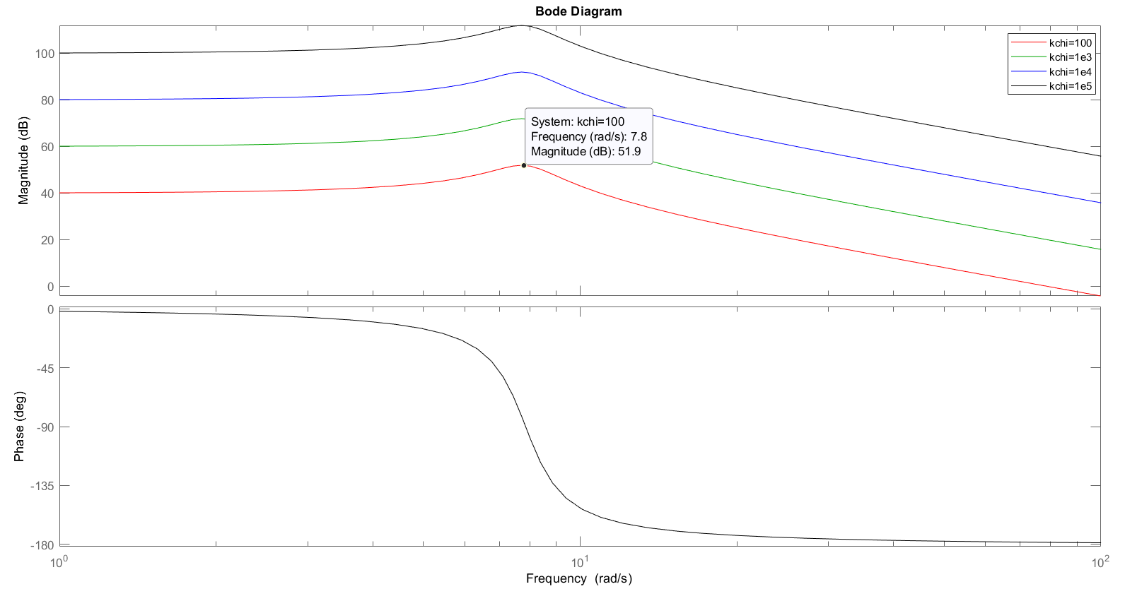
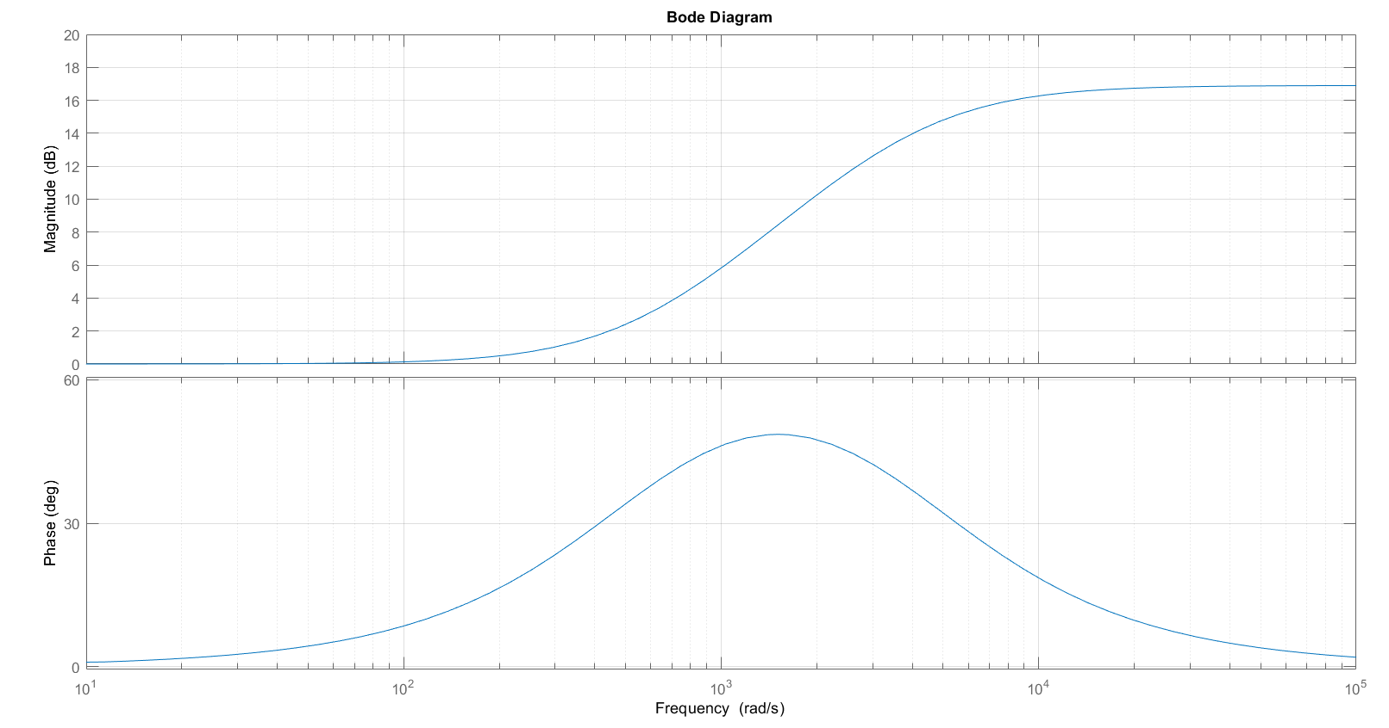




Task 6: Control of bounce and pitch for vehicle model
Design of $H_{∞}$ controller
Weighing functions were designed:
Fig: $W_{z}$
Fig: $W_{χ}$
Fig:${ W}_{a1}=W_{a2}$

Slide 32




Task 6: Control of bounce and pitch for vehicle model
Implementation of $H_{∞}$ controller
Utilized script provided, designed simulation in Simulink
Fig: Simulink implementation $H_{∞}$ controller
Fig: Simulink implementation $H_{∞}$ controller

Slide 33

Task 6: Control of bounce and pitch for vehicle model
Results – Base excitation 1

Slide 34

Task 6: Control of bounce and pitch for vehicle model
Results – Base excitation 2

Slide 35

Task 6: Control of bounce and pitch for vehicle model
Results – Base excitation 3

Slide 36

Task 6: Control of bounce and pitch for vehicle model
Results – Base excitation 4

Slide 37
Thank you
“Questions ..?”
-Us

